Slide 1
CS 205
Artificial Intelligence

Slide 2
Let's play a game: I tell you, you tell me.
We'll start with some training...
I tell you...
You tell me... ?
No!

Slide 3
Let's play a game: I tell you, you tell me.
I tell you...
You tell me... ?
Yes!

Slide 4
Let's play a game: I tell you, you tell me.
I tell you...
You tell me... ?
Yes!

Slide 5
Let's play a game: I tell you, you tell me.
I tell you...
You tell me... ?
No!

Slide 6
Let's play a game: I tell you, you tell me.
I tell you...
You tell me... ?
Yes!

Slide 7
Let's play a game: I tell you, you tell me.
I tell you...
You tell me... ?
Yes!

Slide 8
Let's play a game: I tell you, you tell me.
I tell you...
You tell me... ?
No!

Slide 9
Let's play a game: I tell you, you tell me.
I tell you...
You tell me... ?
Err ... does not compute.

Slide 10
Let's play a game: I tell you, you tell me.
Ok, you're trained.
Let's play!
I tell you...
You tell me... ?
You tell me... ?
You tell me... ?
You tell me... ? Err ...

Slide 11
Let's play a game: I tell you, you tell me.
I tell you...
You tell me... ?
You tell me... ?
You tell me... ?

Slide 12
Let's play a game: I tell you, you tell me.
I tell you...
You tell me... ?
You tell me... ?
You tell me... ?

Slide 13
Let's play a game: I tell you, you tell me.
I tell you...
You tell me... ?
You tell me... ?
You tell me... ?
You tell me... ?
You tell me... ?

Slide 14
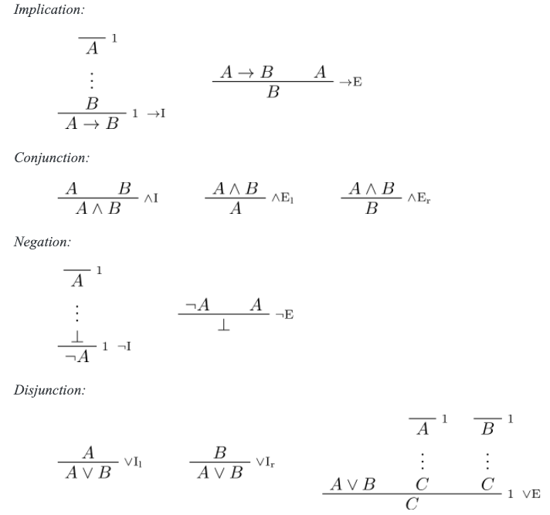
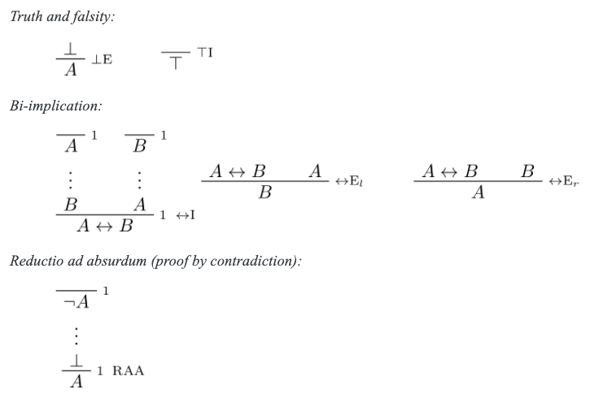


New Game, New Rules: Natural Deduction.
DOWNLOAD:
https://drive.google.com/file/d/1EXKODkS4ovUHDes7YfyrFOwTFIHcpr1g/view?usp=sharing
Source: https://leanprover.github.io/logic_and_proof/natural_deduction_for_propositional_logic.html

Slide 15

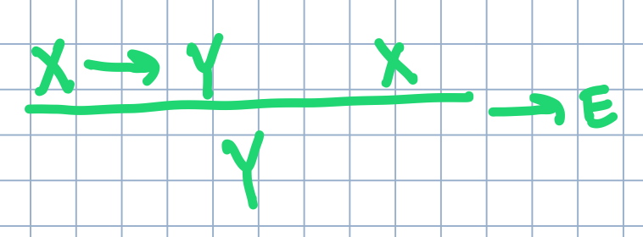
New Game, New Rules: Natural Deduction.
I tell you ...
X→Y X
You tell me ... Y ?
Yes!
Why: because the following rule tells us so.
Let A get X and B get Y. Apply →E. QED.
Read as "implication elimination," →E is a rule of the game. It provides us a pattern of symbols, which tells us a valid step in "the game" of deduction. That pattern represents a deductive reasoning step.
The symbols A and B don't matter. They are merely meta-variables. You can put any symbol you want there as long as they "bind" accordingly.
The way I read it: "Given A→B and A, I can deduce B." Or, you should see it also as a basic if-then rule.
This is also called "Modus Ponens" — it is so famous it has a name.

Slide 16
New Game, New Rules: Natural Deduction.
modus ponens
ex falso quodlibet
DOWNLOAD:
https://drive.google.com/file/d/1EXKODkS4ovUHDes7YfyrFOwTFIHcpr1g/view?usp=sharing
reductio ad absurdum
Source: https://leanprover.github.io/logic_and_proof/natural_deduction_for_propositional_logic.html

Slide 17
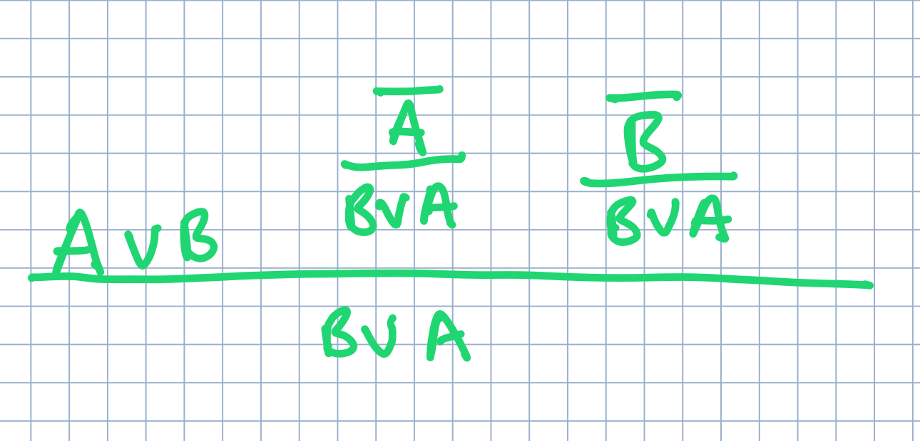
New Game, New Rules: Natural Deduction.
Here's the key insight as to why...
And it doesn't matter if it's A, B or P,Q or X,Z.
You tell me... 𝐴∨𝐵→𝐵∨𝐴 ?
Yes!
But why?

Slide 18
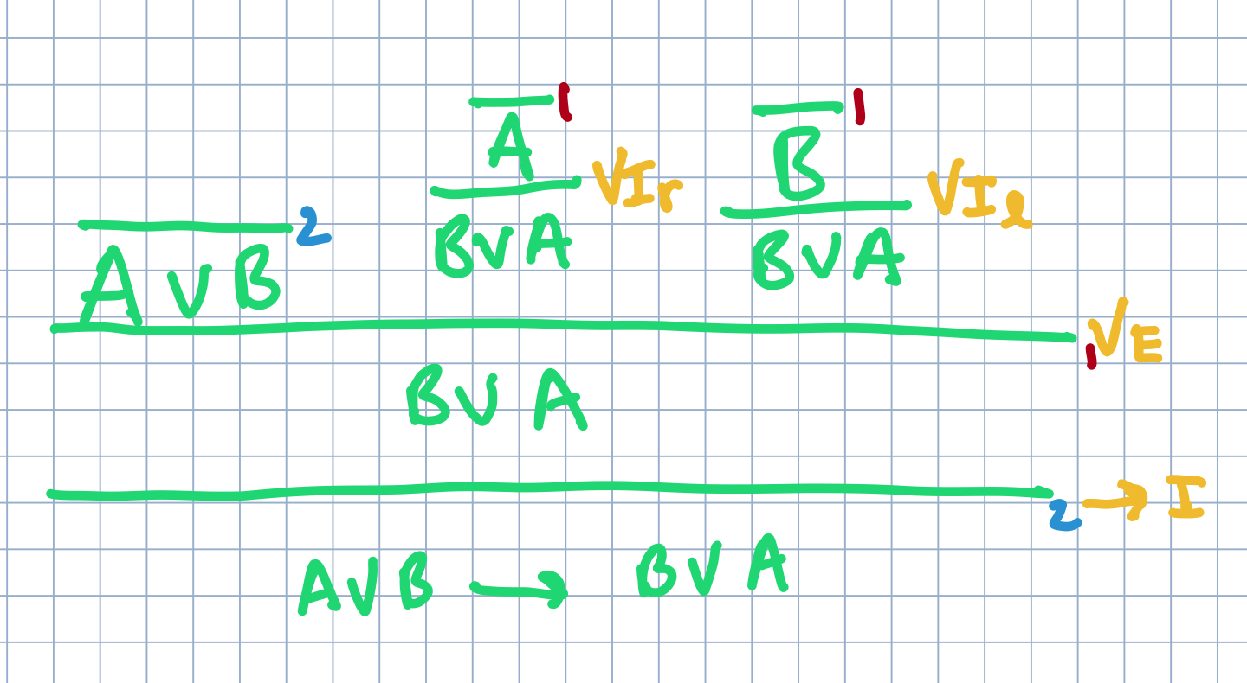
New Game, New Rules: Natural Deduction.
These numbers 1, 2 indicate where the assumption is being eliminated, by what rule application. The number itself is meaningless, they are simply distinct markers. I could just have easily used a ‡ or $ symbol.
Everything needs a proof! Otherwise it remains an assumption.
Something is "proved" if it has a proof tree with no open assumptions.
Here, we have no open assumptions, so the tautology holds and
𝐴∨𝐵→𝐵∨𝐴 is therefore proven.
Yes!
Here's the full proof.
And it doesn't matter if it's A, B or P,Q or X,Z.

Slide 19
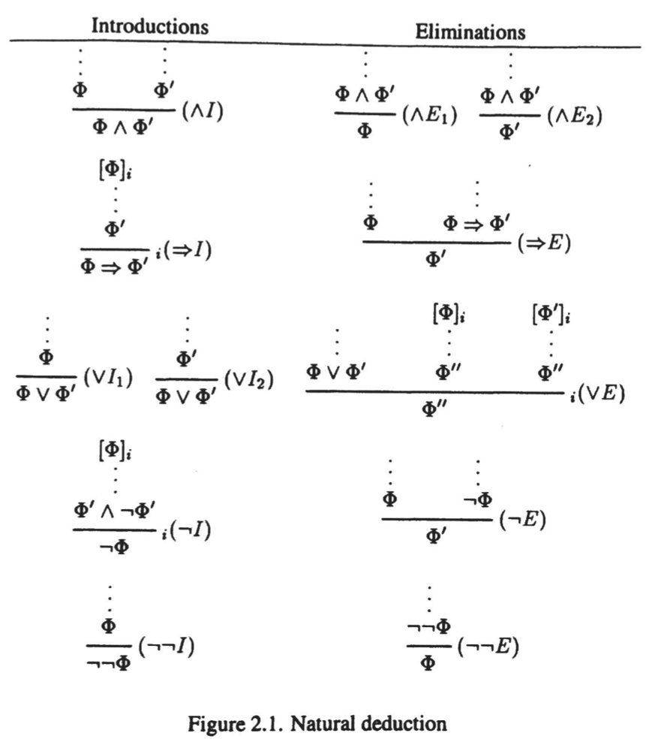
New Game, New Rules: Natural Deduction.
DOWNLOAD:
https://drive.google.com/file/d/1beezryPQZKTsJQYJL2HyOMWsHTsACMKt/view?usp=sharing
Wait a minute... this looks different than before.
Is it still Natural Deduction? That is, is this logic equivalent to what we saw before a few slides ago?
To prove that it is (and in fact it is), you have to prove that every axiom in one is provable from axioms in the other, and vice-versa.
For example: is the ¬¬E (double-negation elimination) axiom provable? Because it surely doesn't exist in the other version we saw earlier?
HINT: this might be a good test question!

Slide 20
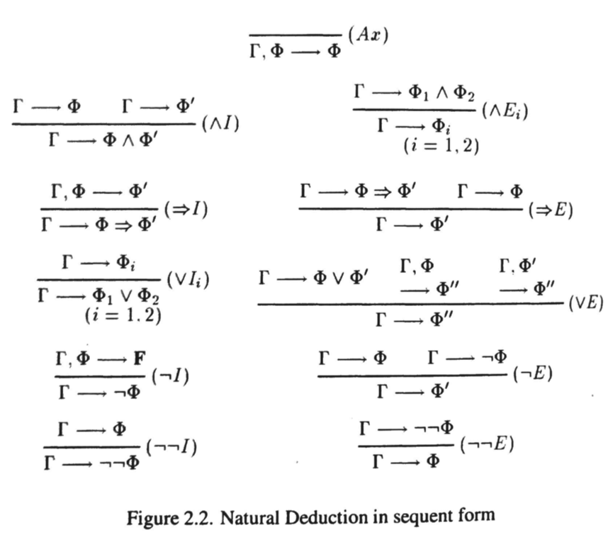
New Game, New Rules: Natural Deduction.
DOWNLOAD:
https://drive.google.com/file/d/1beezryPQZKTsJQYJL2HyOMWsHTsACMKt/view?usp=sharing
I love sequent form!
It is simply a different notation. Nothing more.
Why do I like it? This form more explicitly (in my view) tells me how to handle assumptions. In the other form, you have the numbers 1,2 and the assumption bars, it's not always immediately clear what that means.
Sequent form, uses the Γ ("gamma") symbol, or knowledge base, to more explicitly clarify when precisely an added assumption is made and eliminated. For example, Γ,Φ → Φ', means Φ has been added to the knowledge base. In the ⇒I rule, note, the Φ assumption is eliminated, explicitly!

Slide 21
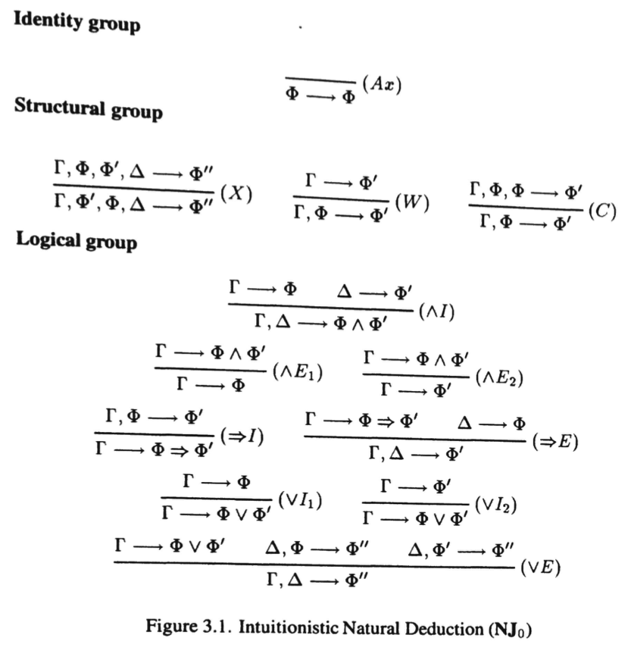
New Game, New Rules: Intuitionistic Logic.
DOWNLOAD:
https://drive.google.com/file/d/1beezryPQZKTsJQYJL2HyOMWsHTsACMKt/view?usp=sharing
Where's the negations?
How is this different than Natural Deduction? Is A V ¬A true in this logic like it is in Natural Deduction? That is, is this statement provable as a tautology?
Commutativity of knowledge base facts, i.e., order does not matter.
What does the (C) rule capture? The (W) rule?

Slide 22
Why are we looking at obscure logic?
Curry-Howard Isomorphism (not AI, more PL, but still important)
Automated Theorem Provers (sort of AI, sort of PL)
Automated Deduction
Knowledge Based Systems
Semantic Web
Description Logic: https://www.researchgate.net/publication/230745455_The_Description_Logic_Handbook_Theory_Implementation_and_Applications
Resource Description Framework (RDF), triplestores
Knowledge Graphs
Computability (P/NP, NEXPTIME, etc.)
Database Theory (e.g., negation as failure)
Prolog, Datalog (again, sort of PL, sort of AI)
*Note: PL is short for Programming Language Theory

Slide 23
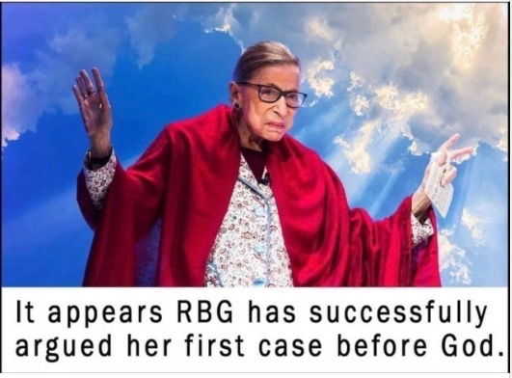

Next time: First-order Logic.
Fun!
All angels get to ask God for one wish.
Happy wife, happy life.
NOTE: I must say, these and any other jokes in no way reflect the opinion of the University.

